Slide 1
Machine Learning Techniques (16CSE09)
Unit – 1 / Sessions 7 & 8
Topics:
Statistical Learning
History of Statistical Learning
Example for Statistical Learning
Function Estimation
Access Model Accuracy

Slide 2
Statistical Learning
Statistical learning refers to a vast set of tools for understanding data.
These tools can be classified as supervised or unsupervised.
supervised statistical learning involves building a statistical model for predicting, or estimating, an output based on one or more inputs.
Problems of this nature occur in fields as diverse as business, medicine, astrophysics, and public policy.
With unsupervised statistical learning, there are inputs but no supervising output; nevertheless we can learn relationships and structure from such data.

Slide 3
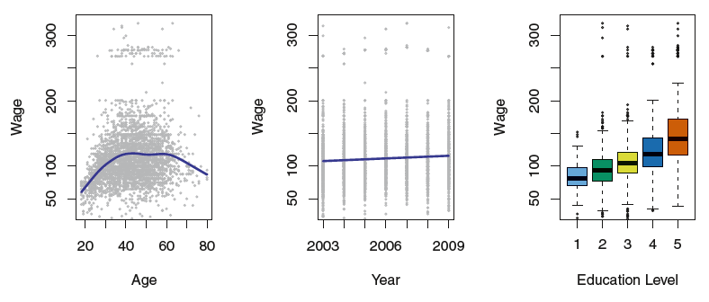
Statistical Learning

Slide 4
Statistical Learning
Wage data: contains income survey information for males.
Left: wage as a function of age.
On average, wage increases with age until about 60 years of age, at which point it begins to decline.
Center: wage as a function of year.
There is a slow but steady increase of approximately $10,000 in the average wage between 2003 and 2009
Right: Boxplots displaying wage as a function of education, with 1 indicating the lowest level (no high school diploma) and 5 the highest level (an advanced graduate degree).
On average, wage increases with the level of education.

Slide 5
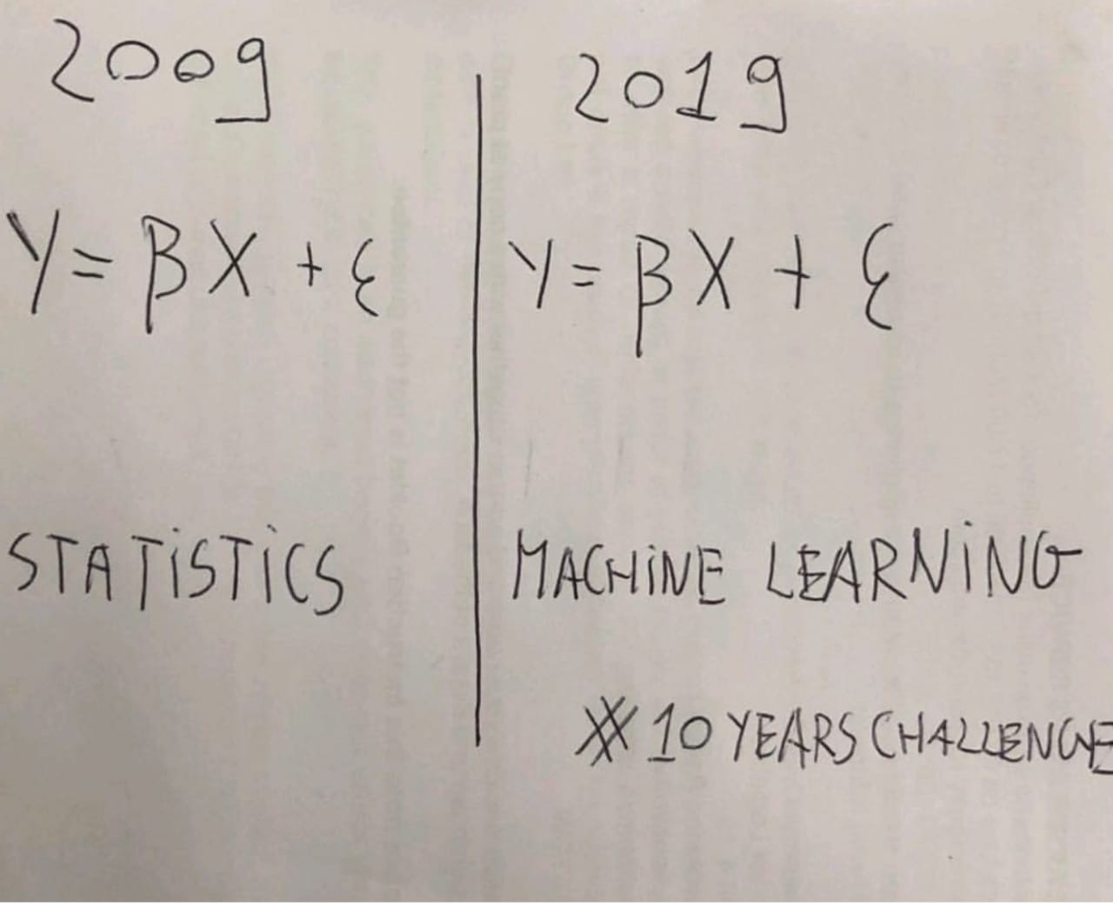
Statistical Learning

Slide 6
History of Statistical Learning
Legendre and Gauss published papers on the method of least squares, which implemented the earliest form of what is now known as linear regression. The approach was first successfully applied to problems in astronomy.
Linear regression is used for predicting quantitative values, such as an individual’s salary.
In order to predict qualitative values, such as whether a patient survives or dies, or whether the stock market increases or decreases, Fisher proposed linear discriminant analysis in 1936.

Slide 7
History of Statistical Learning
In the 1940s, various authors put forth an alternative approach, logistic regression.
In the early 1970s, Nelder and Wedderburn coined the term generalized linear models for an entire class of statistical learning methods that include both linear and logistic regression.
By the 1980s, computing technology had finally improved sufficiently that non-linear methods were no longer computationally prohibitive.
In mid 1980s Breiman, Friedman, Olshen and Stone introduced classification and regression trees, and were among the first to demonstrate the power of a detailed practical implementation of a method, including cross-validation for model selection

Slide 8
History of Statistical Learning
Hastie and Tibshirani coined the term generalized additive models in 1986 for a class of non-linear extensions to generalized linear models, and also provided a practical software implementation
Since that time, inspired by the advent of machine learning and other disciplines, statistical learning has emerged as a new subfield in statistics, focused on supervised and unsupervised modeling and prediction.
In recent years, progress in statistical learning has been marked by the increasing availability of powerful and relatively user-friendly software.

Slide 9
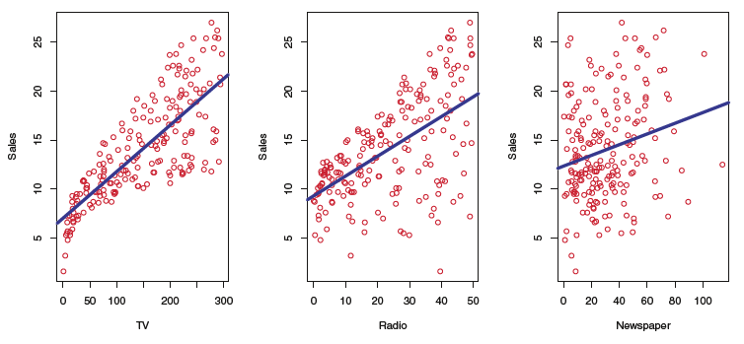
Example for Statistical Learning
Suppose that we are statistical consultants hired by a client to provide advice on how to improve sales of a particular product.
The Advertising data set consists of the sales of that product in 200 different markets, along with advertising budgets for the product in each of those markets for three different media: TV, Radio, and Newspaper
The Advertising data set: The plot displays sales, in thousands of units, as a function of TV, radio, and newspaper budgets, in thousands, for 200 different markets.

Slide 10
Example for Statistical Learning (Cont…)
It is not possible for our client to directly increase sales of the product.
On the other hand, they can control the advertising expenditure in each of the three media.
Therefore, if we determine that there is an association between advertising and sales, then we can instruct our client to adjust advertising budgets, thereby indirectly increasing sales.
In other words, our goal is to develop an accurate model that can be used to predict sales on the basis of the three media budgets

Slide 11
Example for Statistical Learning (Cont…)
The advertising budgets are input variables while sales is an output variable.
The input variables are typically denoted using the symbol X, with a subscript to distinguish them.
So X1 might be the TV budget, X2 the radio budget, and X3 the newspaper budget.
inputs / predictors / independent variables / features / sometimes just variables.
The output variable, in this case, sales is often called the response or dependent variable, and is typically denoted using the symbol Y.

Slide 12
Example for Statistical Learning (Cont…)
More generally, suppose that we observe a quantitative response Y and p different predictors, X1,X2, . . .,Xp.
We assume that there is some relationship between Y and X = (X1,X2, . . ., Xp), which can be written in the very general form:
Y = f(X) + ϵ, ϵ is the random error term
In this formulation, f represents the systematic information that X provides about Y.

Slide 13
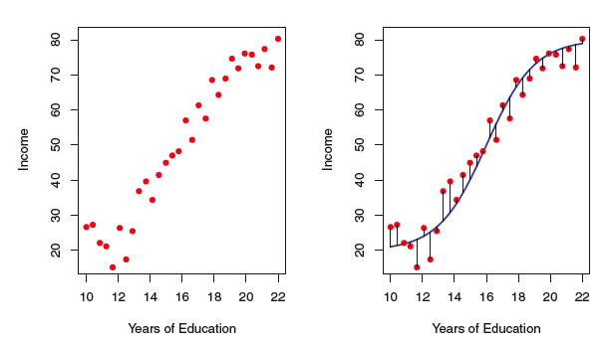
Plot of income versus years of education for 30 individuals in the Income data set
The plot suggests that one might be able to predict income using years of education. However, the function f that connects the input variable to the output variable is in general unknown.
In essence, statistical learning refers to a set of approaches for estimating f.

Slide 14

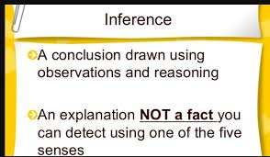
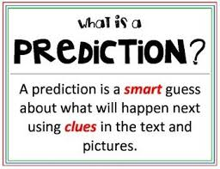
Why Estimate f?
There are two main reasons that we may wish to estimate f:
Prediction
Inference

Slide 15
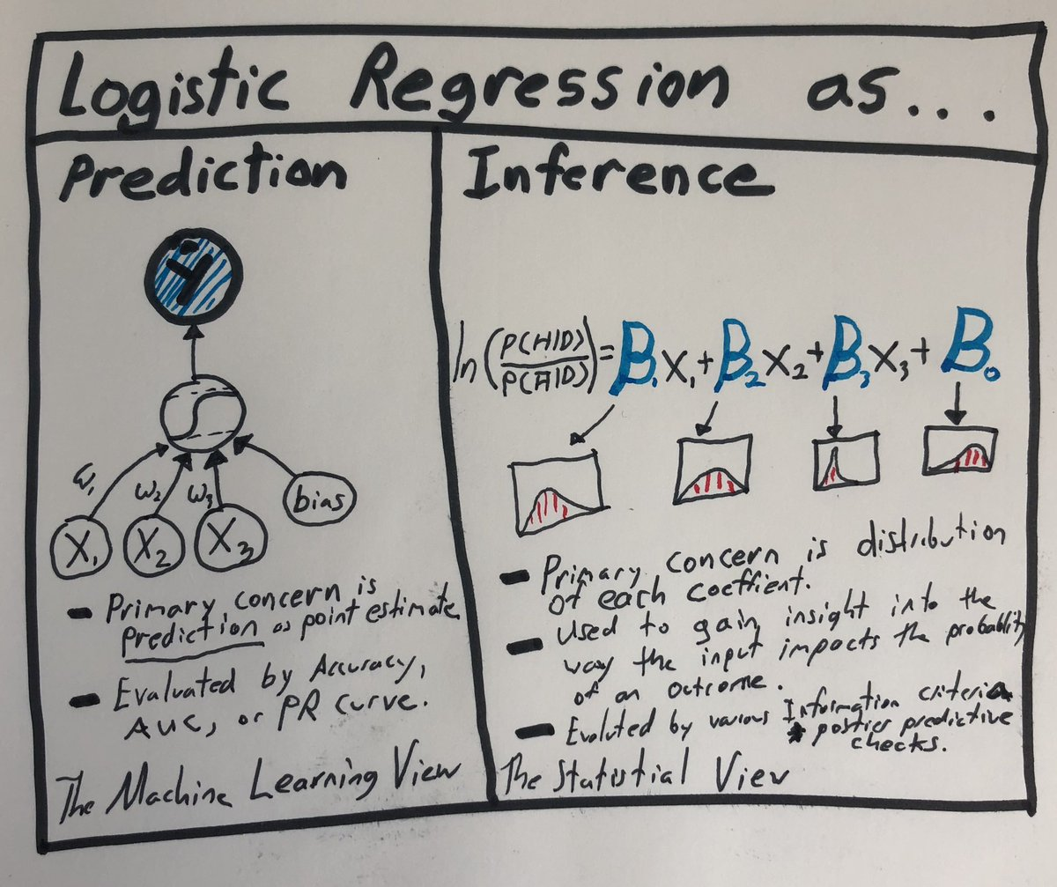

Slide 16
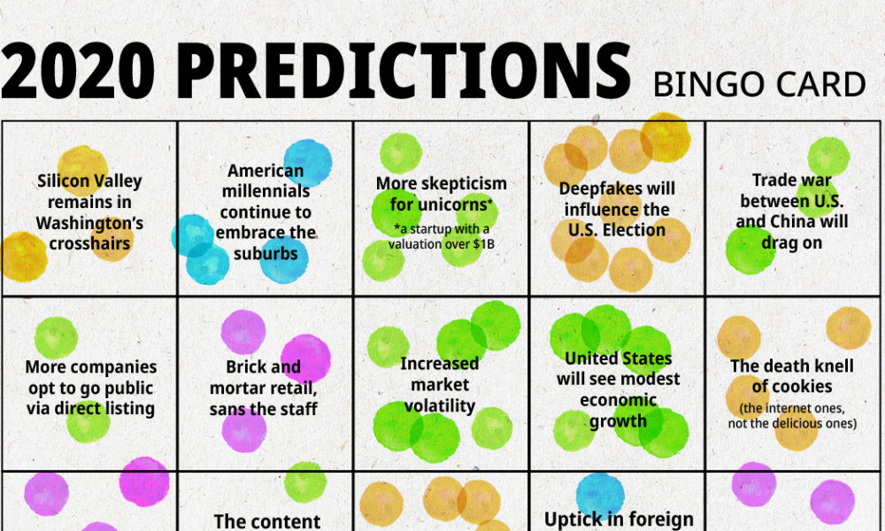
Why Estimate f?

Slide 17
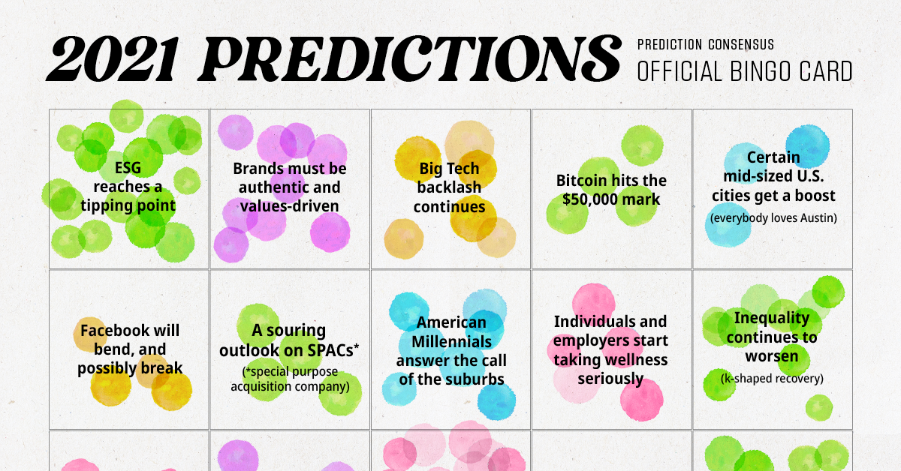
Why Estimate f?

Slide 18
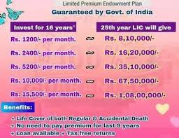
Why Estimate f?

Slide 19
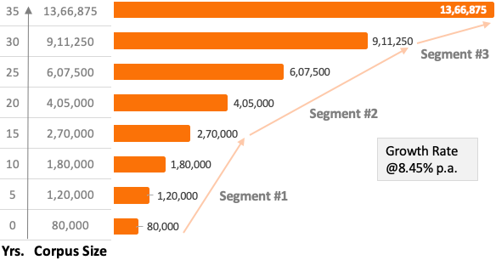
Why Estimate f?

Slide 20
Summary
In this session,
Statistical Machine Learning
Function Estimation
Measuring the accuracy of model
Thank You

